Slide 1
Function Overrides
from a Security mitigation to a powerful Performance Feature in Windows 11 SV2
Andrea Allievi (@aall86)
04th June 2022 - Recon

Slide 2
Who I am
Italian CORE OS Architect, mainly focused on Windows Kernel developing
Microsoft OSs Internals enthusiast / Security Researcher
Work for the Security Core OS Team of Microsoft Ltd
Previously worked in the Threat Intelligence Center of Microsoft (MSTIC), in the TALOS Security Group of Cisco Systems, Webroot and Saferbytes
Original designer of the first UEFI Bootkit, Patchguard 8.1 bypass in 2014, Windows Intel PT Driver, and many other research projects…
Since 2016 I am responsible of the Secure Kernel development
Main developer of Retpoline and Import Optimization, KDP, and many others Kernel features…
AND, especially, …

Slide 3
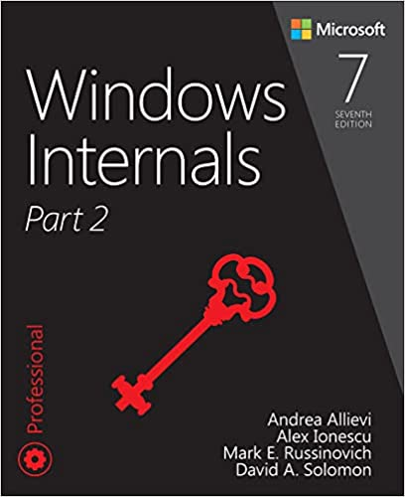
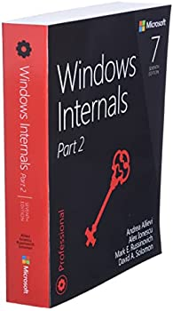
One of the
Main authors ☺

Slide 4


Outline
Part 1. Introduction
Control Flow Guard (CFG)
Retpoline & Import Optimization
Limitations and Issues
Part 2. Function Overrides
Goals & Motivations
Overview, OS & Compiler support
Implementation
DVRT entries and BDT
Part 3. Closing thoughts
Conclusions
Demo - Q & A

Slide 5
Part 1 - Introduction

Slide 6
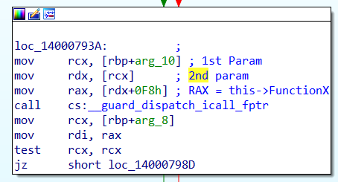
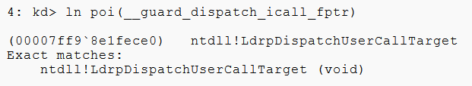
Control Flow Guard (CFG)
Everyone knows what it is ☺. Famous Security mitigation that protect indirect calls through pointers
Makes uses of CFG Bitmaps and some function pointers addresses by the IMAGE_LOAD_CONFIG data directory
Notes:
Each 2 bits in the CFG bitmap for 16 bytes of VA space

Slide 7

Control Flow Guard (CFG)
CFG Bitmap track the valid call targets (2 bits per each 16-bytes of VA space)
Only the Kernel can update the Bitmap
Evolved in Extended Flow Guard (XFG), which protects also the function signatures through signature hashes...
XFG bit shared with Export suppressed function (not callable via the EAT)
Implementation in the NT kernel and Windows Loader (NTDLL)
Kernel CFG (KCFG) implemented in the Secure Kernel
Different dispatch function in the Kernel when Retpoline is enabled.

Slide 8
Retpoline
4c 8b 15 XX XX XX XX mov r10,qword ptr KeQueryPerformanceCounter
E8 YY YY YY YY call _guard_retpoline_import_r10
5 bytes direct REL32 call to the Retpoline Import guard function
48 8B 45 10 mov rax, [rbp+10h]
48 8B 57 F8 mov rdx, [rdi-8]
49 03 CC add rcx, r12
E8 YY YY YY YY call _guard_retpoline_indirect_cfg_rax
41 8B 94 80 . . . mov edx, [r8+rax*4+6BCCD4h]
49 03 D0 add rdx, r8
E8 XX XX XX XX call nt!_guard_retpol_switch_jump_rdx
5 bytes direct REL32 call to the Retpoline Indirect function
5 bytes direct REL32 call to the Retpoline SwitchTable guard function
Retpoline is a security feature designed to Prevent Spectre v2 attacks in the Kernel
Replaces all the indirect branches to direct calls towards the Retpoline routine:
CALL Setup_target
Capture_Spec:
; Any speculation barrier or loop
INT 3
Setup_Target:
MOV QWORD PTR [RSP], RAX
RETN

Slide 9
Retpoline & Import Optimization
Different kinds of Retpoline “thunks” described by the Dynamic Value Relocation Table (DVRT)
Proven to be a perf. win because of Kernel software not needed to run with IBRS on.
Implemented in the NT and Secure Kernel only for Kernel drivers.
Uses another bitmap to track which kernel module is Retpoline compatible.
If the bit in the Bitmap is 0, IBRS will be enabled (or an IBPB is emitted).
Evolved in Import Optimization, which removes any indirect call to imported function.
Performance win, 5/ 6% additional improvement compared to systems with just Retpoline on.
See my 2018 blog post (link) and BlueHat talk (link)...
Notes:
Each bit 64KB of region of address space

Slide 10

Limitations and Issues
In modern CPUs, indirect calls are expensive by definition. Better to avoid them.
CFG and XFG are a cool security features but offer NO more room in their format
Retpoline, Import Optimization are *not* generic
Applies to Kernel modules only.
No room for expansion (linker does strict validation).
Performance issues:
With VBS, doing a TLB flush every time a module is loaded is expensive (longer process startup time).
ARM64EC adds another bitmap to the Kernel.
Based on the hardware characteristics / policies, the features can be dynamically enabled or disabled.
What about if we need another Security mitigation in the OS Kernel???
Notes:
Explain here:
VirtualProtect - write the pointer - VirtualReprotect
That Retpoline format is *NOT* particular extensible. One of the issue was that the linker does strict validation on the .retpol section (which contains DVRT entries). Unused bits are validated to 0 for the linker.
What if adding a new mitigation?
Today - setting function pointers in the Load Config <-- ANNOYING
Add entry in the Load Config
Visual studio need to be modified for the new Load Config (anyone who have a CRT)
The NT Kernel / or the loader should be modified for using this new dynamic function pointers.

Slide 11
Part 2 – Function Overrides
A joint effort between different teams in Microsoft:
MORSE (Joe Bialek)
Security Core Team (Andrea Allievi)
Visual C++ (Pranav Kant)
Others...
Notes:
MORSE = Microsoft Offensive Research and Security Engineering

Slide 12

Disclaimer
All the material presented from this slide can slightly change in future versions of Windows
Function Overrides is included in SV2 but currently disabled due to some incompatibility with AV drivers (of course ☹). Will be enabled soon!
The C++ Compiler team is building a more-user friendly interface for third parties
Stay tuned!

Slide 13
Goals & Motivations
Create a Generic way to add security mitigations that requires dealing with function pointers.
Single binary that takes advantage of newer CPUs while maintaining compatibility with older ones
Allow alternate function implementations to be used without the overhead of indirect calls
Useful for security features and general performance tuning
The technology should be able to seamlessly work with both user and kernel modules, and with third-party software (later in its design process)
Features enabled/disabled on per-binary basis

Slide 14

Overview
Liberty to write performant architecture-specific functions with negligible overhead.
“I have a way to make memcpy 30% faster on Alder Lake”
memset_avx
memset_ermsb
memset_sse4
OS Loader
Metadata
Function Override on Call sites

Slide 15
OS & Compiler Support
Developer defines a generic function that can be specialized when certain capabilities (like AVX, MPX, ...) are exposed by the OS
Generic and Specialized functions implemented and compiled as usual
Developer defines a "decision tree" that is compiled into the PE as metadata. The loader reads the metadata to make decisions *
New linker flags forces the linker to generate the Binary decision tree and Function overrides information in the final PE file
When loaded, the OS recognizes the information and applies Function Overrides.
* Internally, the decision tree is specified by a special file. A special tool compiles it in a OBJ file format. Both are not available externally. The Compiler Team is working on enabling special C/C++ attribute to allow developers to describe the tree.
Notes:
Available soon to Externals
Special tool name: CVTFO.exe - processes OVR files
Linker flags: “/funcoverride” and “/funcoverrideoncallsites”
In a OVR file, the developer defines a “decision tree”, which allow the specialized functions to be used instead of the generic ones.
The OVR is compiled (by a specialized tool) in a OBJ file, which is linked with the rest of the project.

Slide 16
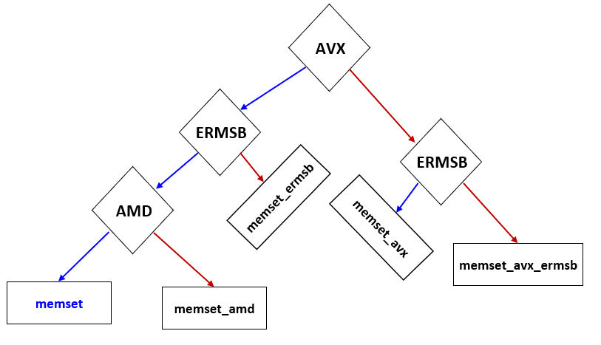
Example of a BDD descriptor (preview)
!version:1
#include <overridecapabilities.h>
#if defined(_AMD64_)
memset
OVRDCAP_AMD64_AVX & OVRDCAP_AMD64_ERMSB, __memset_spec_avx_ermsb
OVRDCAP_AMD64_AVX, __memset_spec_avx
OVRDCAP_AMD64_ERMSB, __memset_spec_ermsb
OVRDCAP_AMD64_CPU_MANUFACTURER_AMD, __memset_spec_amd
#endif
(More details in slide 23 ☺)
Notes:
Comment the simplicity of the model
Enhanced REP MOVSB for memcpy - https://stackoverflow.com/questions/43343231/enhanced-rep-movsb-for-memcpy
See slide 23 for the visual representation of the BDT

Slide 17

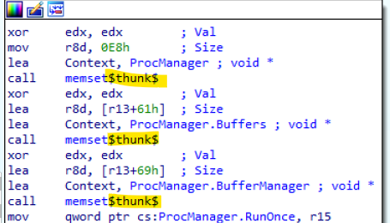
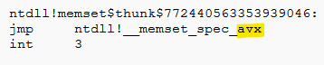
What about Exported functions?
Exported functions can still be specialized using the “classical” form of Function Overrides, which makes uses of “thunk” routines
memset_avx
memset_ermsb
memset_sse4
OS Loader
Metadata
N.B. Everything is a *direct* jump
Classical Function Override
Notes:
Note that everything is a DIRECT jump

Slide 18

Implementation - Boot Drivers
Implemented in various part of Windows:
Almost all the function overrides routine are exposed via the RTL layer⁺ (generic and usable by all environments)
The Windows loader, in the “prepare” phase, calculates bitmaps of both NT and SK capabilities (user and kernel mode, see RtlInitFunctionOverrideCapabilities)
It then parses the DVRT and applies function overrides to the NT and Secure Kernel*
When the Secure Kernel starts, it (re)calculates the exposed capabilities
The NT kernel starts and applies Function Overrides to all its boot drivers (exposed as a contiguous virtual memory ranges)
When HVCI is enabled, the NT kernel can *not* touch any executable page, so invokes SK via the PERFORM_DRIVER_FUNCTION_OVERRIDES secure call.
Notes:
Note that everything is a DIRECT jump
+ Yes, where the GSL::Span have been used as already detected by Alex.
* SK - All of its dependent modules
NOTE 2: Windows loader does *NOT* apply the fixups is because of the OS special function (marked using Special capabilities).

Slide 19
Implementation - Runtime Drivers
Runtime drivers are really different than Boot drivers.
NT MM (Memory manager) always associate them with a Control Area (CA) - Advanced features like memory sharing and pageability
At section creation time, when MM decides the preferred ASLR base address, it parses the Image Load config and capture Function Override data.
Overrides are applied to the shared pages in the validation path, or in the in-paging path, to single pages (using the RtlApplyFunctionOverrideFixups routine).
Private fixups and large pages use another similar path.
When HVCI is on, the NT kernel can *not* touch executable pages -> only SK become the only entity able apply Function Overrides.
Similar technology in SKCI <- Secure Kernel Code Integrity
Notes:
Explain what is a private-fixup. Private fixup = applied when the image can not be mapped at its chosen ALSR base address, on private pages mapped with RWX access rights.

Slide 20
Implementation - User-mode modules
Executable user-modules are always loaded by NT MM, in a similar way for runtime drivers:
Always associated with a Control Area, shareable
Private fixups are more likely to happen
Similar application path for Runtime drivers
Function Override engine decides which overrides to apply (user vs kernel) to a page based on its preferred ASLR base address
User-modules can be mapped also in a Trustlet / Trusted App -> SK should support Function Overrides in its validation path.

Slide 21
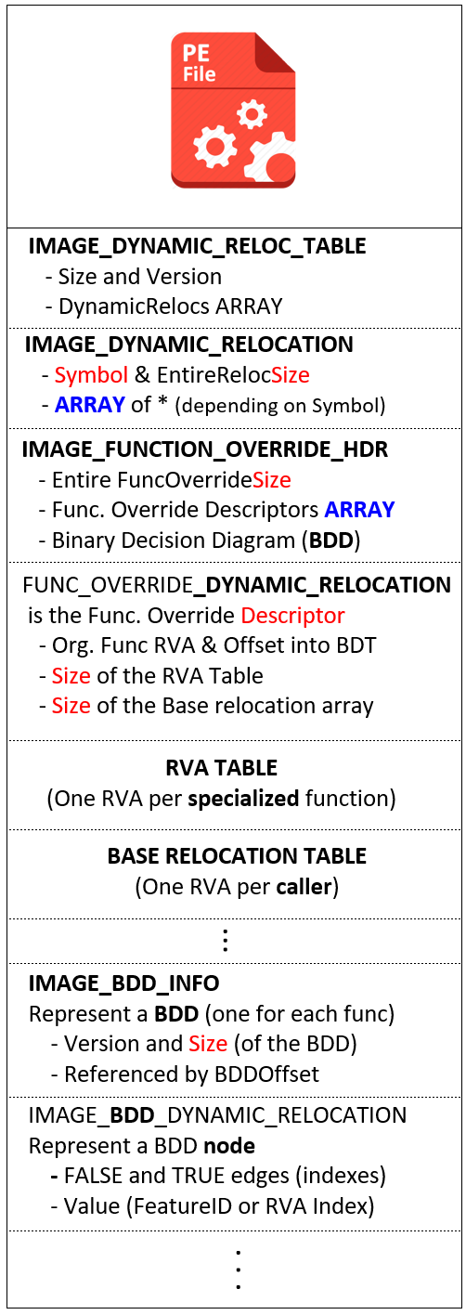
DVRT entries
In the PE file, Function Overrides are described by new Dynamic Value Relocation Table (DVRT) entries.
The DVRT is addressed by the Image Load Configuration directory.
Function Overrides are addressed by Dynamic Relocation entries
BDD after the Dynamic Relocation data
Notes:
PE = Portable Executable
DVRT = Dynamic Value Relocation Table

Slide 22
The Binary Decision Diagram (BDD)
A binary tree described by an array of IMAGE_BDD_DYNAMIC_ RELOCATION data structure located in the DVRT.
Each node in the decision tree specifies a “capability” (such as AVX support) that the OS provides via a header in the SDK (overridecapabilities.h).
If the capability is supported by the OS, the “right” (true) node is visited.
Otherwise, the “left” (false) node is visited.
When the leaf node is reached in the decision tree, it contains an index into a RVA Table.
The RVA Table contains a RVA of each specialized function targeted by the BDD.
Leaf nodes are identified by the Left node being equal to the Right one
Notes:
https://en.wikipedia.org/wiki/Binary_decision_diagram

Slide 23
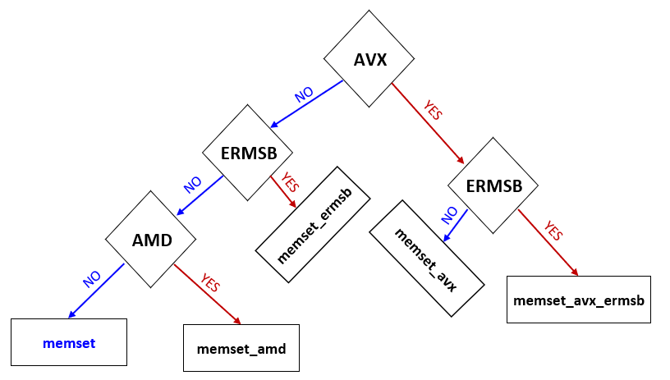
The Binary Decision Diagram (BDD)

Slide 24
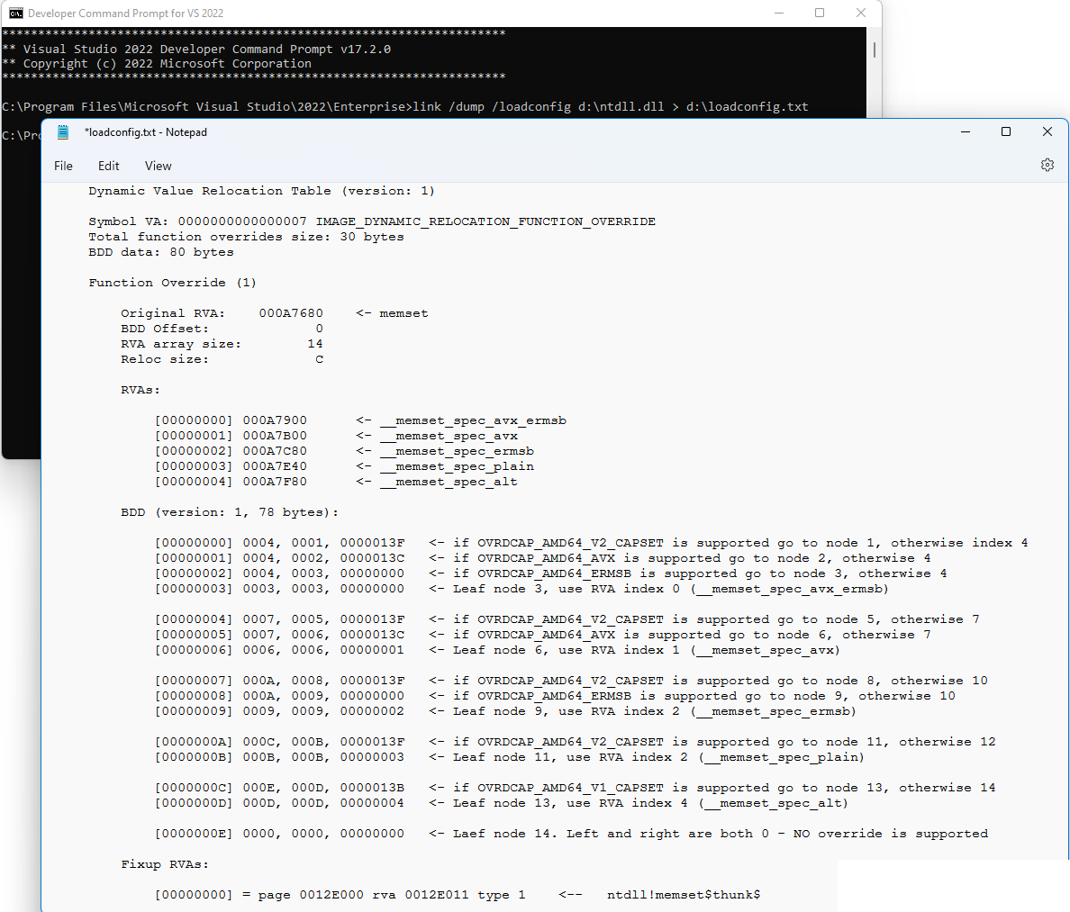
A real case - Ntdll

Slide 25

No, I was just joking….
Wooow! Seriously? ☺
Do we have still time available?

Slide 26
Part 3 – Closing thoughts
Function override is cool?

Slide 27
Conclusions
Function Overrides is new technology that allows MS to add new Security mitigations on function pointers with almost 0 perf. issue
Applicable everywhere, also for non-security functions
Initial Performance Tests are promising
Technology still not completely ready for third parties (but it will soon)
More work to do (XSAVE support in Secure Kernel is not completed yet)
Visual Studio 2022 + latest Windows 11 & SDK Insider release has initial support.
Bonus, latest SDK includes also SKTool
As usual, Stay tuned! 😊
Notes:
SDK: https://www.microsoft.com/en-us/software-download/windowsinsiderpreviewSDK
Windows Insider: https://www.microsoft.com/en-us/software-download/windowsinsiderpreviewiso
Visual Studio 2022: https://visualstudio.microsoft.com/downloads/

Slide 28

We are hiring talented people!
Multiple positions available in the HV, Kernel Core and (my) Security Core teams
Write me a mail if interested: andreaa@microsoft.com
Notes:
SDK: https://www.microsoft.com/en-us/software-download/windowsinsiderpreviewSDK
Windows Insider: https://www.microsoft.com/en-us/software-download/windowsinsiderpreviewiso?rfs=1
Visual Studio 2022: https://visualstudio.microsoft.com/downloads/

Slide 29


Slide 30

Thanks for Attending Recon!
Andrea Allievi (@aall86)
Joe Bialek (@JosephBialek)
Pranav Kant (@pranvk)
Microsoft Ltd
andreaa@microsoft.com

